Slide 1


Focus on Wellness

Slide 2
FOCUS on WELLNESS
Introduction
Recovery and Renewal
Sample of Activities
What’s Next

Slide 3
INTRODUCTION
Promoting the quality of life for our team of staff, contractors and volunteers was a key element of Vision 2020.
Strategic plan included a series of goals and action items, including a renewed focus on wellness.
Recognized increasing pressure on staff with increasingly complex care environment and safety risks.
Wellness Committee established in 2018 to oversee and help coordinate Three Links retention, recognition, training and professional development policies.
Committee, initially chaired by CEO, includes senior staff, contractors, volunteer coordinator and administrative support.

Slide 4
INTRODUCTION
Wellness Committee has promoted and developed series of activities since being established:
  Training and Professional Development Policy
  Long Service Awards
  Credit Card Rewards Program (peer nominated)
  Regular special events
  Adopted FSEAP for provide coaching services for staff and families
  Conducted regular wellness and satisfaction surveys
  Story-telling videos
  Recognition weeks
  Regular participation in SafeCare BC activities
  Ongoing professional training on-site
  Recreation, rehab and care aide unification planning
Wellness focus paid off during pandemic. Little to no staff attrition during difficult time and sector-wide human resource crisis.
Committee remained active during the pandemic and outbreak.

Slide 5
RECOVERY and RENEWAL
Entire team traumatized post-outbreak
Risk of second COVID-19 outbreak through third and fourth waves
Entire long term care system under severe stress; “Our 9/11”
Leadership Team declared 2021 as Year of Recovery and Renewal
Four-phase work plan published in February 2021

Slide 6
RECOVERY and RENEWAL
Goals
Promote wellness and quality of life for residents and team members in a post outbreak environment
Recognize the courage of our Three Links team
Properly grieve beloved residents that passed away during the outbreak
Strengthen infection control measures to prevent future outbreaks
Provide staff, contractors, residents, family members and community partners with an opportunity to shape the Care’s Centre’s future

Slide 7
RECOVERY and RENEWAL
2021 Work Plan
PHASE ONE | PHASE TWO | PHASE THREE | PHASE FOUR
Infection Control (January – February) | Wellness and Engagement (March – April) | Continuous Quality Improvement (May - August) | The Future (September- December)

Slide 8
SAMPLE of ACTIVITIES
  Counselling Services
  FSEAP counsellor met onsite with staff (management excluded) while maintaining safety precautions
  Counsellor held in person sessions with entire staff with use of communication carts
  Leadership group met with counsellor for follow up / debrief
  We now offer group counselling with staff on a quarterly basis
  Currently looking into new programing within our organization to promote overall wellbeing

Slide 9
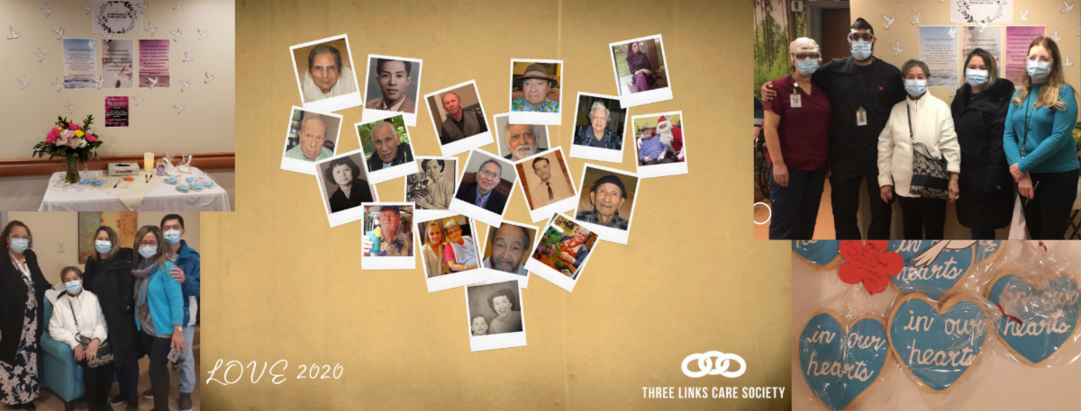
SAMPLE of ACTIVITIES
Memorial April 7th , 2021
Staff, residents and families were invited to remember those we lost in a safe and meaningful way.
5 duplicated tributes were placed through the facility to ensure staff safety
We had messages of love, poetry and a beautiful video of our lost loved ones.

Slide 10
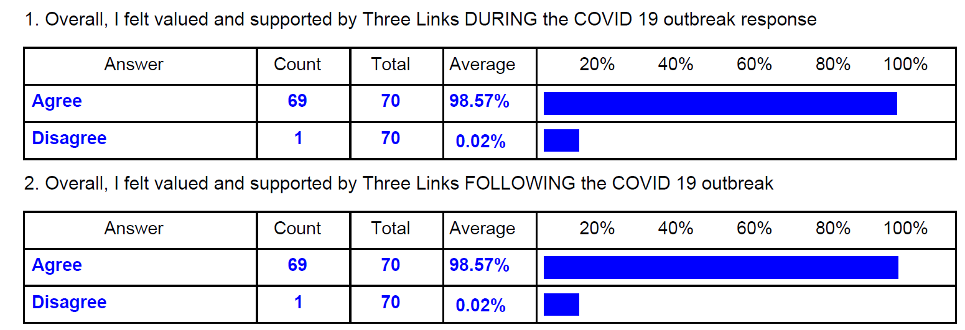
SAMPLE of ACTIVITIES
EMPLOYEE SURVEY (April)
RESPONSE RATE AT 54% (total of 70 submissions)
Highlights
Staff comments
Great place to work.
Keep up the great work. Honoured to be part of this team.
It was a nightmare experienced for everybody..but thankfull and grateful to the threelinks management coz we get all the support that we need..
You did an amazing job!
Felt secure and like TLC cared
The outbreak was a very stressful time. But, I am glad that all of us stood together and got out of it. The measures taken after the outbreak and regular communication from time to time made things easier. It is great to see that proper screening procedures, rapid testing and priority vaccination was made available to all the staff at three links.
I think the facility did a good job with handling the situation.

Slide 11
SAMPLE of ACTIVITIES
  Calendar of Events
  Promoting team wellness through calendar recognition, education and appreciation events and activities:
  Pink Shirt Day (Feb)
  Story Telling (March – April)
  Employee Long Service Awards (Ongoing)
  Volunteer Recognition (April)
  Emergency Preparedness and Safety (May)
  Nurse Recognition (May)
  Support Services (June)
  Administration Staff Recognition (June)
  Team Unification (July)
  Province-Wide Butterfly Memorial Event (July)
  Credit Card Reward Events with MP and MLA (Summer)
  Care Aide Recognition (October)
  Allied Care recognition (November)

Slide 12
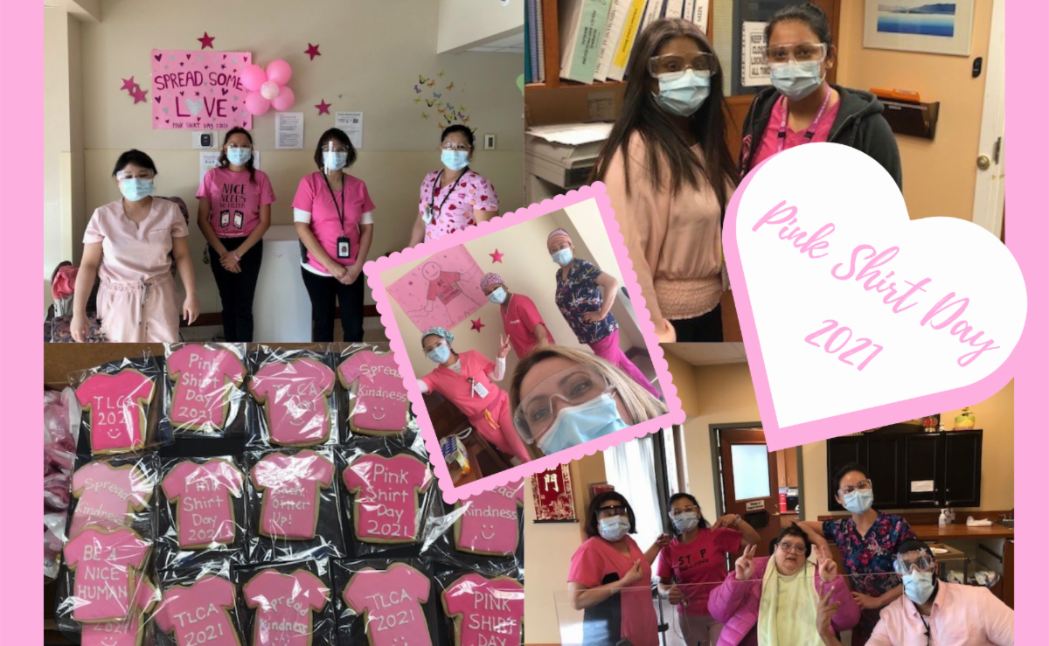
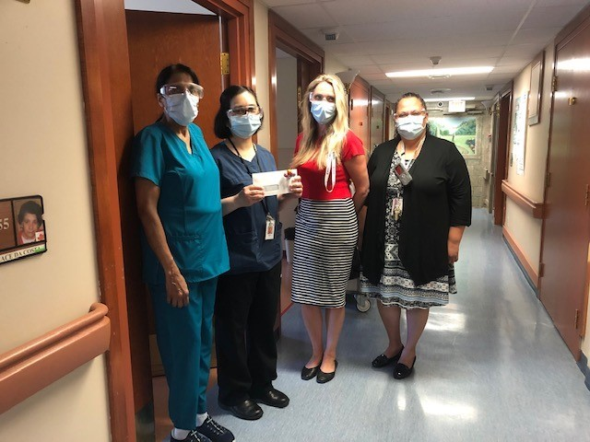
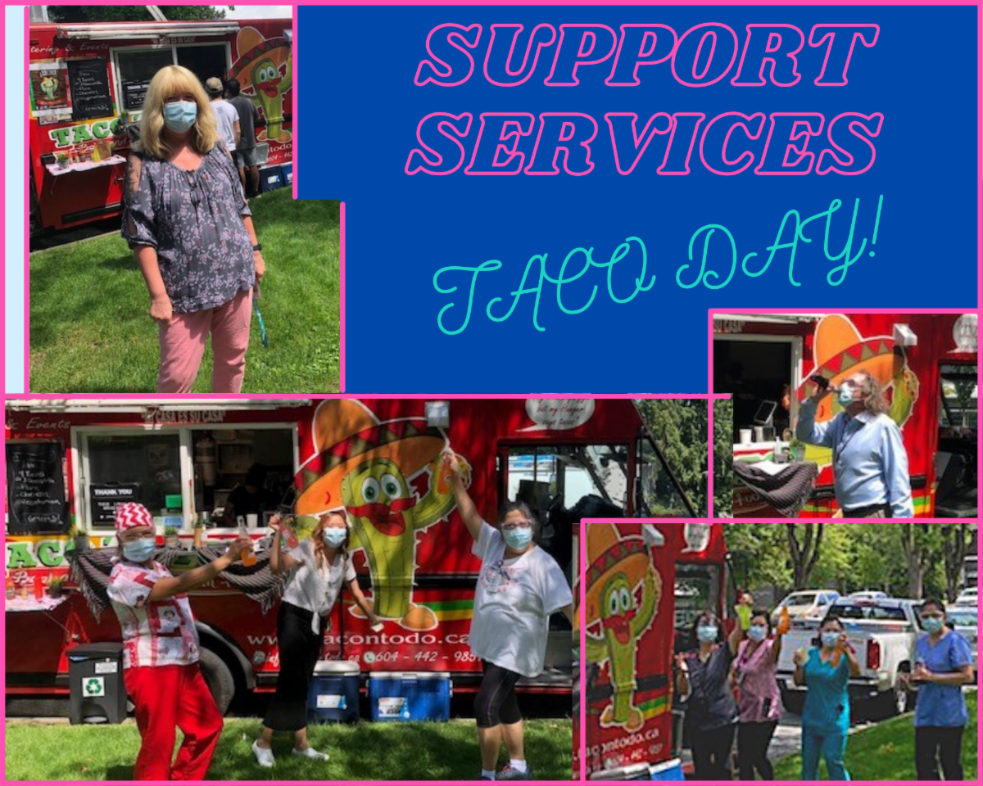
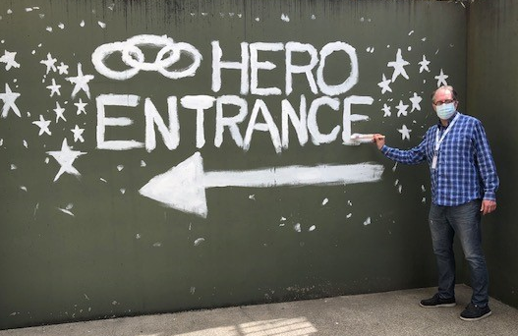
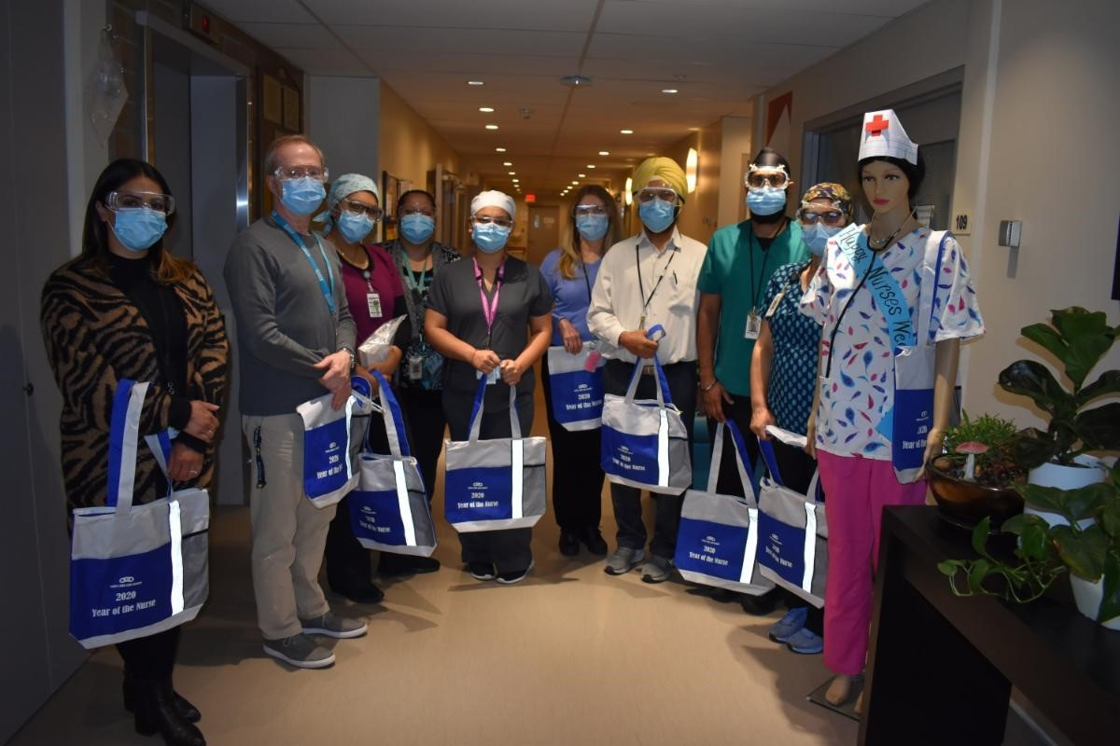
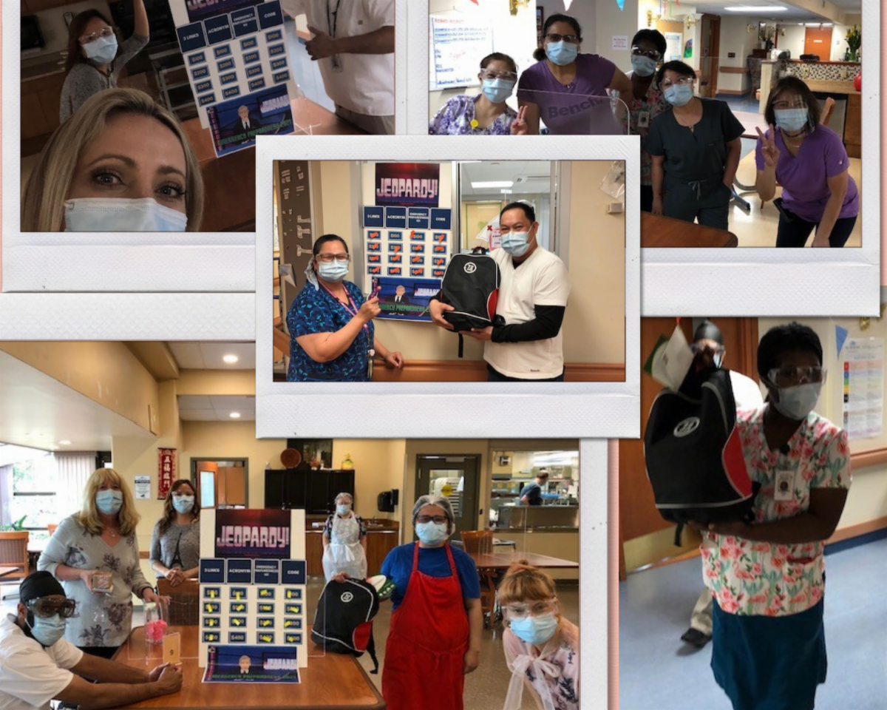
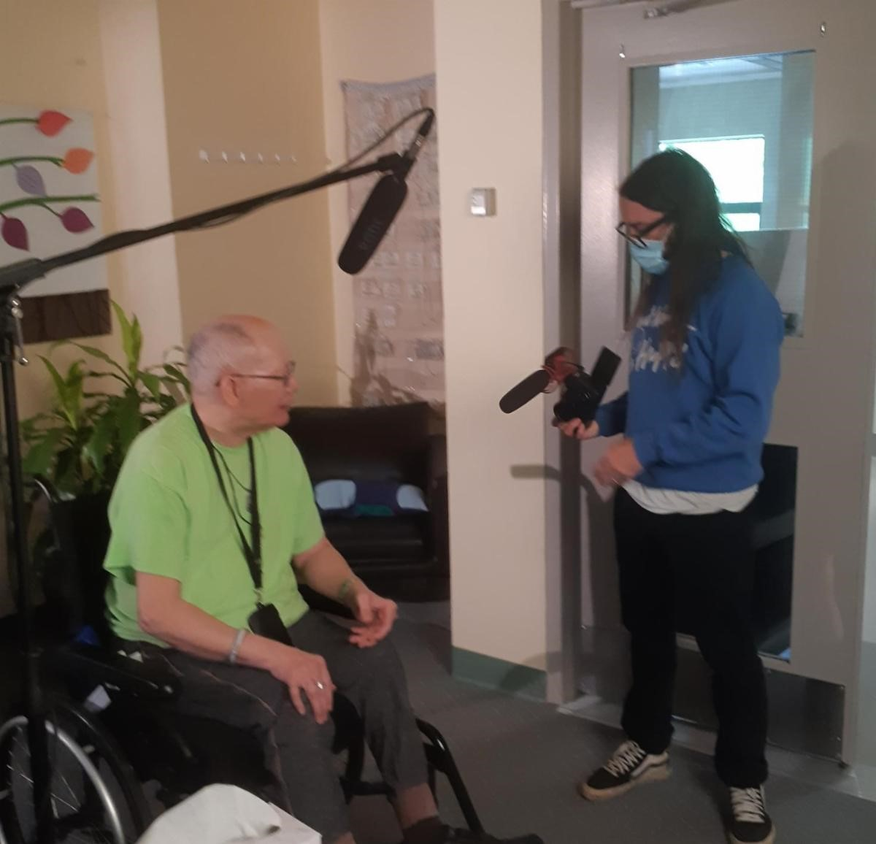
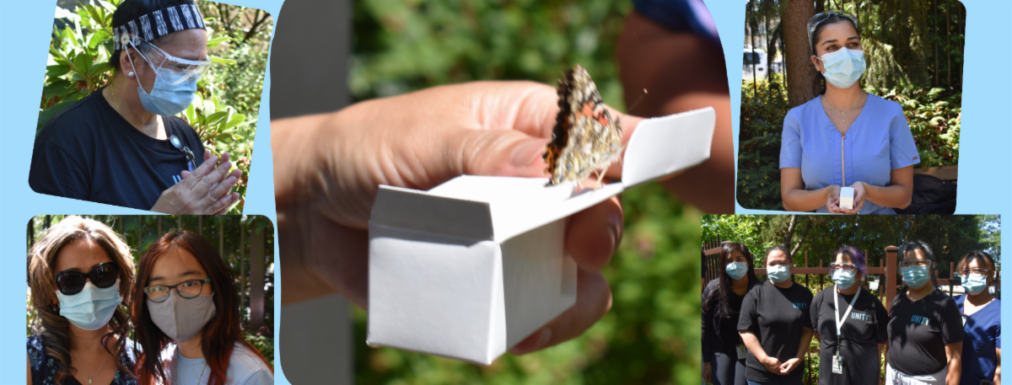

Slide 13
SAMPLE of ACTIVITIES
  Infection Control
  Safety = Wellness for staff, residents and families
  Continued PPE measures
  Screening onsite from 6am – 11pm Monday thru Sunday
  Social distancing remains in effect for staff breaks
  Rapid testing onsite
  Goggle usage remains in effect for direct care
  99% vaccination rate
  Third dose preparation
  Refining our Pandemic Management Checklist

Slide 14
SAMPLE of ACTIVITIES
Post-Outbreak Admissions
Increasingly complex resident transfers from public health presenting challenges and increasing risk, particularly related to:
Addiction issues
Younger resident population
Ability to provide appropriate programing
Environment for residents
Impact on staff
Staff education and skills sets
Increased training, professional development and strategic planning will be required to address this emerging sector trend.

Slide 15
SAMPLE of ACTIVITIES
CQI Review
Three Links Leadership group attended a July retreat lead by independent CQI consultant:
The Leadership Team completed a review of the past few months and what steps are require to maintain Leader’s wellness.
Leadership identified the following as being the “High Priority”
Action plan update through deliverables & indicators
Slow down | Coaching /get the techniques/someone to vent to
Celebrating success/take the time | Anticipate workload with new projects
Team events/fun | Acknowledge limitations

Slide 16
WHAT’S NEXT?
Complete phase three and four of Recovery and Renewal work plan
Prepare for fourth wave and third vaccination of staff and residents
Training and planning re: complex new admissions
Integrate families and volunteers into our wellness initiatives
Continue to work with and integrate Employee assistance (FSEAP)
Complete special projects: Story-telling video and Memorial Garden
Implement 2021 Wellness Calendar
Prepare for one-year outbreak anniversary of our Outbreak
Wellness planning for 2022

Slide 17
THANK YOU
Questions and Answers

